Slide 1
XG BOOSTING ALGORITHM

Slide 2
What is XG Boosting
The XG Boosting algorithm, short for eXtreme Gradient Boosting, is an advanced machine learning technique that excels in predictive modeling for both classification and regression tasks.
XG Boost is a highly efficient and customizable implementation of gradient boosting, and it is widely preferred for its scalability, speed, and superior performance on large and complex datasets.
Key Concepts of XG:
XG Boost employs regularization techniques to reduce over fitting and improve generalization.
The algorithm leverages parallel processing, cache awareness, and out-of-core computation to efficiently train on large datasets.

Slide 3
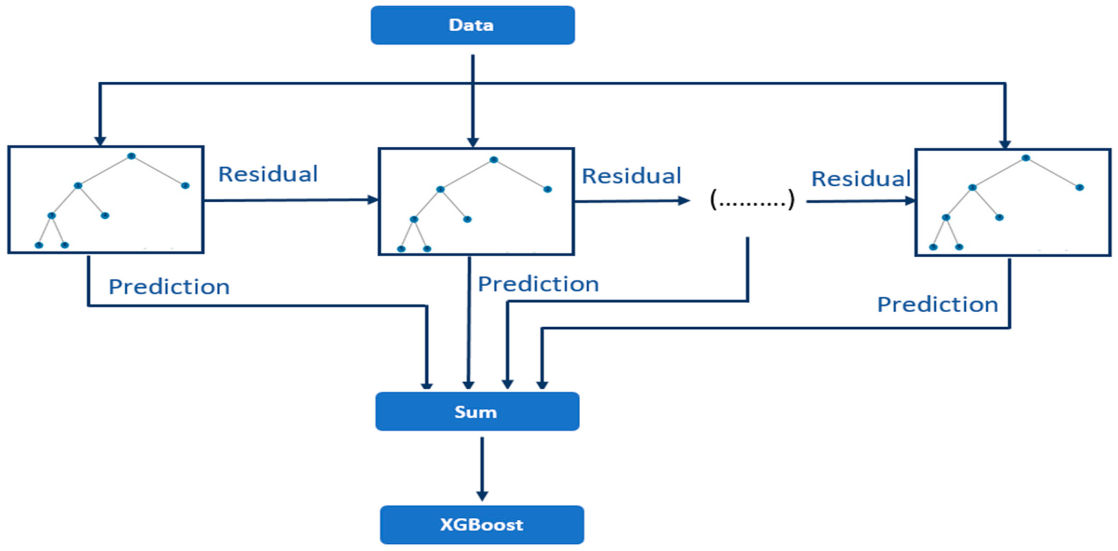
How XG boost works

Slide 4
Use cases of XGboost:
XGboost are mainly used in following fields:
Stock Market Prediction
Fraud Detection in Finance
Time Series Forecasting
Healthcare Outcome Prediction

Slide 5
Pros and Cons of XG Boosting
High Performance and Accuracy
Efficient Handling of Large Datasets
Flexibility
Handles Missing Values
Complex Parameter Tuning
High Memory Usage
Risk of Over fitting
Verbose and Complex Output

